Slide 1
Resturant web Page

Slide 2
Functional Requirements
1. Home Page:
Display restaurant details, high-quality images, and daily specials.
Link to menu, reservations, and contact pages.
2. Menu Page:
Display categorized menu items with descriptions, images, and prices.
Filter options for dietary preferences.

Slide 3
3. Online Reservation System:
Reservation form with customer details, date, time, and party size.
Send confirmation via email or SMS.
4. Online Ordering System:
Shopping cart functionality to select items, view cart, and checkout.
Payment integration for online orders.

Slide 4
5. Contact Page:
Display address, contact number, email, and Google Maps location.
Contact form for customer inquiries.
6. About Us Page:
Restaurant history, mission, and team information with photos.
7. Specials and Offers Page:
Display current offers or events.

Slide 5
8. User Account:
Registration/login system to manage orders and reservations.
View order and reservation history.
9. Reviews and Testimonials:
Display customer reviews and allow new review submissions.
10. SEO and Social Media Integration:
Integrate social media sharing and SEO-optimized pages.

Slide 6
Non-Functional Requirements
1. Usability: User-friendly and intuitive design, responsive across devices.
2. Performance: Fast page loading, smooth interactions, and caching.

Slide 7
3. Scalability: Able to handle increased traffic during peak hours.
4. Reliability: Ensure uptime, with error handling for failed transactions.
5. Security: SSL encryption, secure payment, data protection (GDPR compliance).
6. Compatibility: Cross-browser compatibility.
7. Maintainability: Easily updatable by non-technical staff.
8. Accessibility: WCAG-compliant for accessibility.

Slide 8
Functional Requirements
1. Home Page:
Requirements: Attractive layout with restaurant details, high-quality banner images, daily specials, and links to other pages.
Technologies:
Frontend: HTML, CSS (with frameworks like Bootstrap or Tailwind CSS), JavaScript.
Backend: Node.js, Express.js (or Django, if using Python).
Database: MongoDB or MySQL (for storing daily specials or any dynamic content).

Slide 9
2. Menu Page:
Requirements: Display categorized menu items, prices, descriptions, and images; filter options for dietary preferences.
Technologies:
Frontend: HTML, CSS, JavaScript (React or Vue.js for dynamic UI).
Backend: Node.js, Express.js (or Django).
Database: MongoDB or MySQL to store menu details.

Slide 10
3. Online Reservation System:
Requirements: Reservation form with customer details, date, time, and party size; send confirmation notifications via email or SMS.
Technologies:
Frontend: HTML, CSS, JavaScript (React or Vue.js for form validation).
Backend: Node.js with Express.js.
Database: PostgreSQL or MongoDB.
Notifications: Integration with Twilio (for SMS) or SendGrid (for email).

Slide 11
4. Online Ordering System:
Requirements: Cart system to add items, view and modify cart, checkout, and payment processing.
Technologies:
Frontend: HTML, CSS, JavaScript (React or Angular for interactive components).
Backend: Node.js, Express.js.
Database: MongoDB or MySQL.
Payment Processing: Stripe or PayPal SDKs for secure transactions.

Slide 12
5. Contact Page:
Requirements: Display address, phone number, email, social media links, and Google Maps integration.
Technologies:
Frontend: HTML, CSS, JavaScript.
API: Google Maps API.
6. About Us Page:
Requirements: Information about the restaurant's history, values, and team, plus a photo gallery.
Technologies:
Frontend: HTML, CSS, JavaScript (React or Vue.js if dynamic content).
Database: PostgreSQL or MySQL to store gallery images and content.

Slide 13
7. Specials and Offers Page:
Requirements: Display promotional offers or events.
Technologies:
Frontend: HTML, CSS, JavaScript.
Backend: Node.js or Django for managing dynamic content.
Database: MongoDB or MySQL.
8. User Account:
Requirements: Allow users to create accounts, view orders/reservations, and save preferences.
Technologies:
Frontend: HTML, CSS, JavaScript.
Backend: Node.js or Django (with JWT or OAuth for user authentication).
Database: MySQL or PostgreSQL for user data.

Slide 14
9. Reviews and Testimonials:
Requirements: Display customer reviews and allow new reviews to be submitted.
Technologies:
Frontend: HTML, CSS, JavaScript (React or Vue.js for UI updates).
Backend: Node.js, Express.js.
Database: MongoDB for easy management of text-based review data.
10. SEO and Social Media Integration:
Requirements: Integrate social media platforms and enable page/item sharing.
Technologies:
Frontend: Open Graph and Twitter meta tags for SEO.
Backend: Node.js for metadata rendering.

Slide 15
Non-Functional Requirements
1. Usability:
Technologies:
Frontend: Bootstrap or Tailwind CSS for responsive design; UX design with Figma or Adobe XD.

Slide 16
2. Performance:
Technologies:
Frontend Optimization: Lazy loading for images and minification of JavaScript and CSS.
Backend Optimization: Node.js with caching mechanisms (Redis).
Database Optimization: Indexed queries in MySQL or MongoDB for faster retrieval.

Slide 17
3. Scalability:
Technologies:
Backend: Microservices architecture with Docker for deployment.
Database: PostgreSQL for horizontal scaling; Redis for session management.
Hosting: AWS or Google Cloud Platform for auto-scaling and load balancing.

Slide 18
4. Reliability:
Technologies:
Backend: Node.js with load balancing and fallback mechanisms.
Database: MySQL or PostgreSQL with replication for high availability.
5. Security:
Technologies:
Frontend: HTTPS for secure communication.
Backend: Implement JWT for user authentication; input validation and sanitation to prevent XSS or SQL injection.
Database: Role-based access control (RBAC) in MySQL/PostgreSQL.

Slide 19
6. Compatibility:
Technologies:
Frontend: Cross-browser testing with tools like BrowserStack.
CSS Frameworks: Tailwind CSS for better cross-device support.
7. Maintainability:
Technologies:
Code Management: Git for version control.
Modular Code: Modularized backend with Express.js or Django apps.
Documentation: Swagger for API documentation.

Slide 20
8. Accessibility:
Technologies:
Frontend: ARIA labels and WCAG compliance with accessibility testing tools (e.g., Lighthouse, Wave).

Slide 21
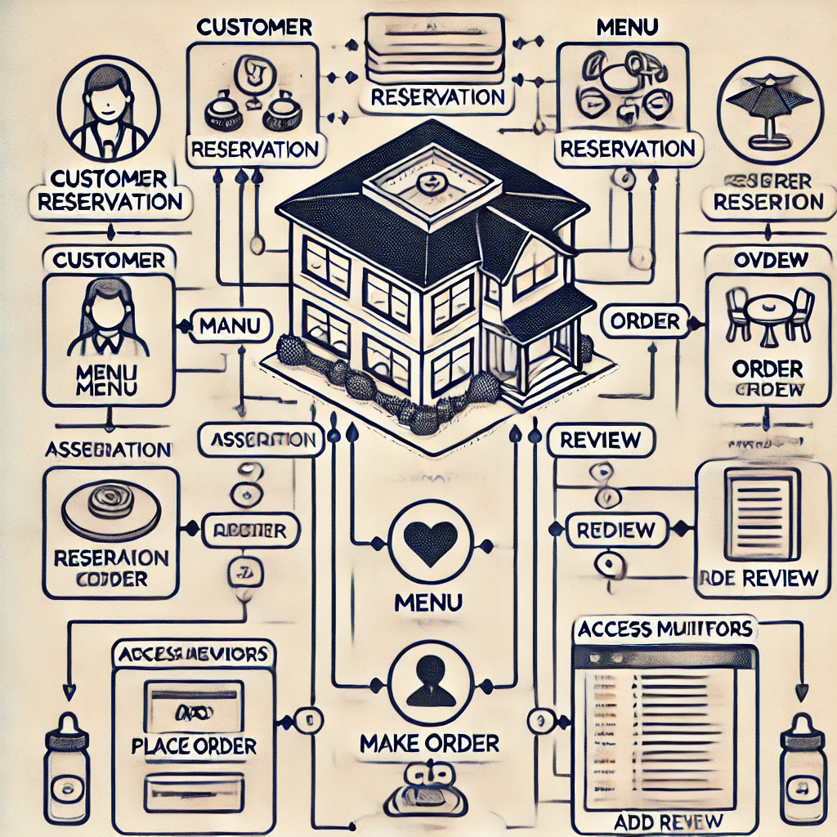

Slide 22
View Menu
Make a Reservation
Place an Order
View Offers
Contact Restaurant
Create Account

Slide 23
Manage Menu
Manage Reviews
Manage Reservations
Manage Offers
Manage Orders

Slide 24
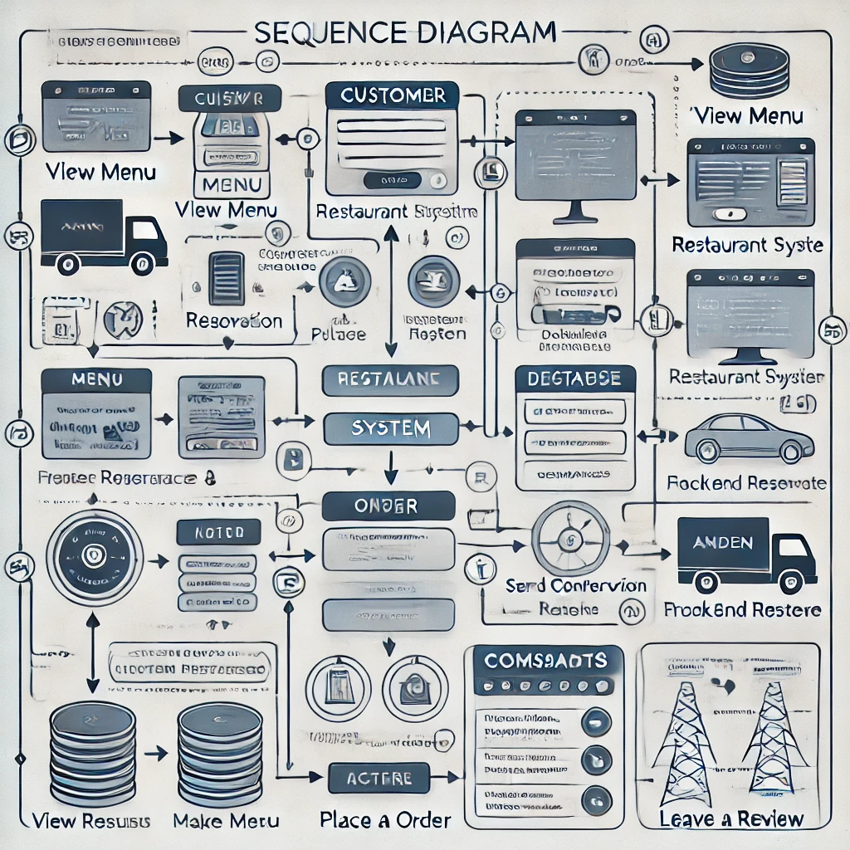

Slide 25
